Slide 1
Elephant Trunk Molding
For Soft Robotics
Presented by: Sana Pournaghshband
Faculty Mentors: Dr. David Hu and Dr. Jia Ning Wu
December 1, 2017

Slide 2
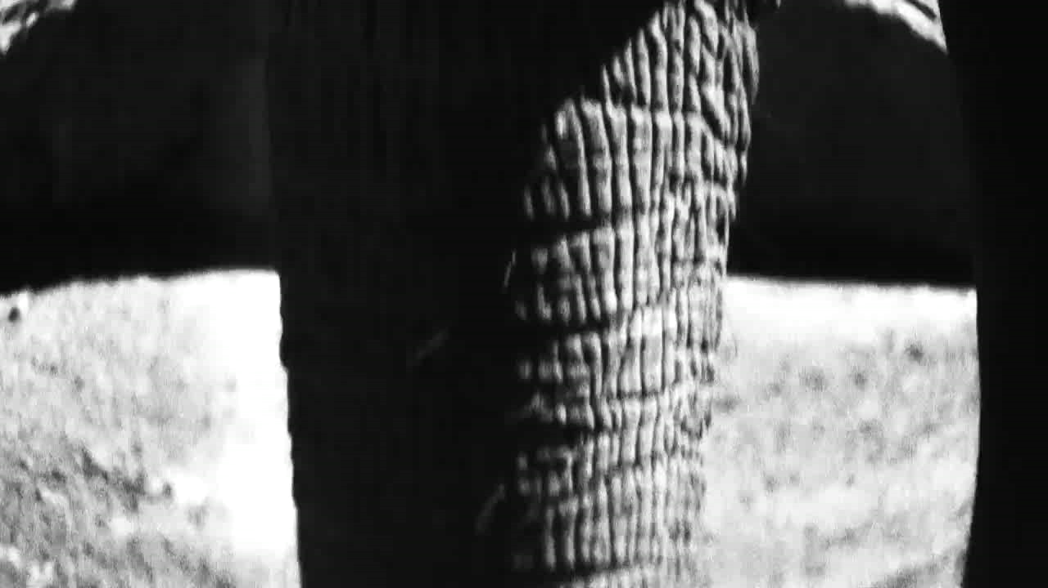
The elephant trunk is a dexterous gripper

Slide 3
Research aim
Get the detailed 3D structure of the trunk tip
Investigate the advantage of the special trunk structure in grabbing
Generate next-generation grippers

Slide 4
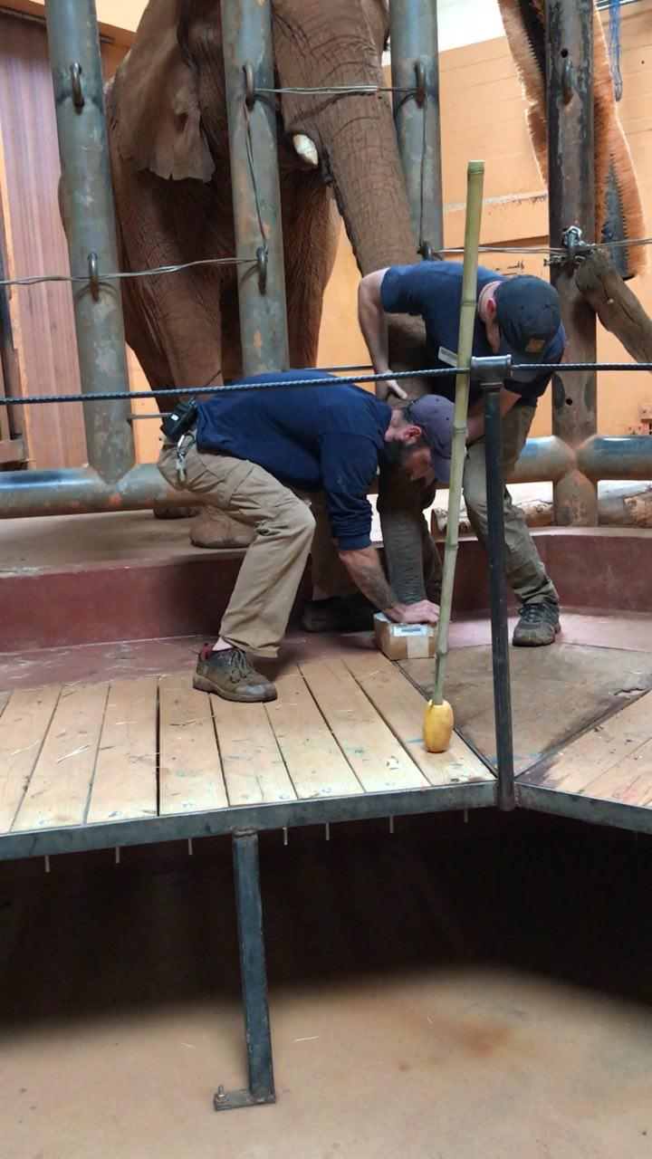
First trial-Clay Mold
Zoo Staff helping us to made a mold of the trunk tip in the prepared clay box

Slide 5
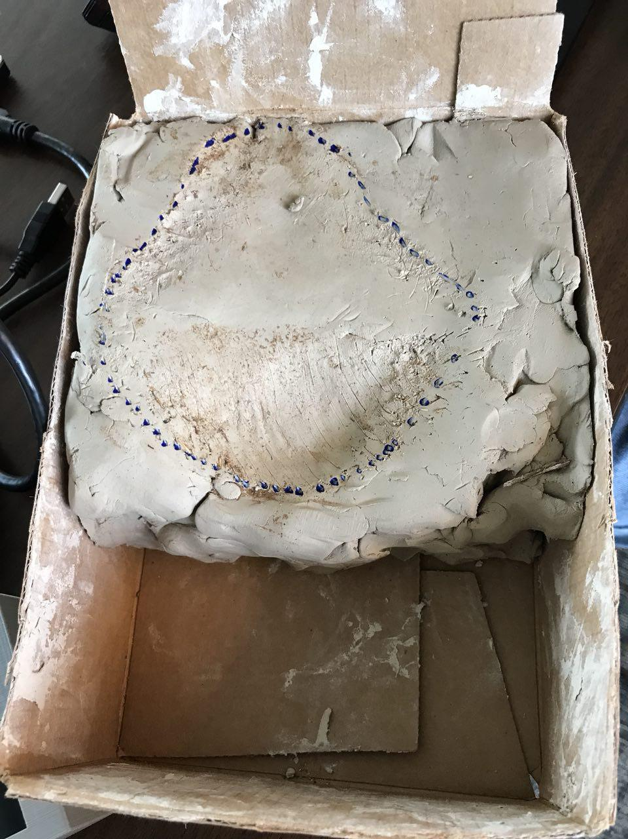
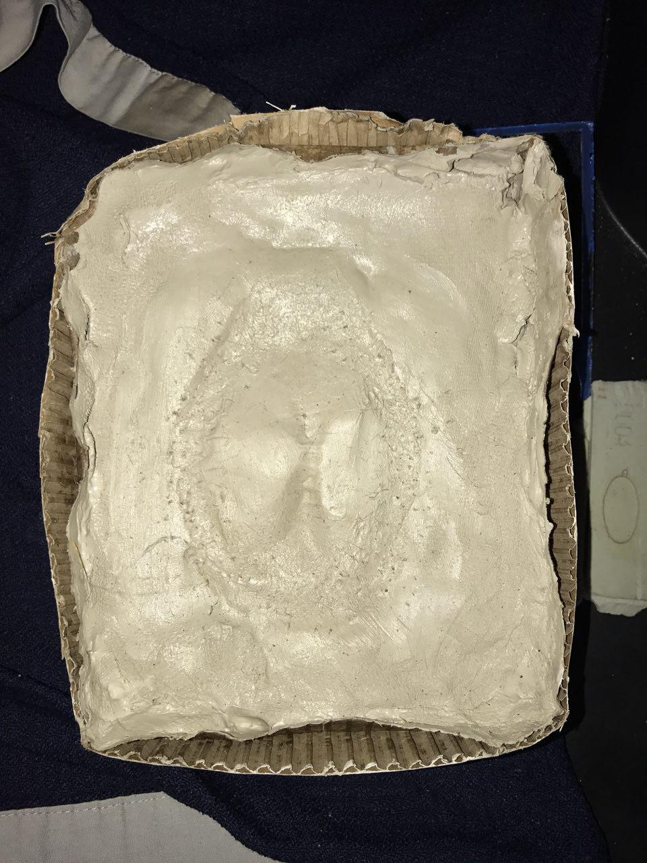
First clay molding Second attempt

Slide 6
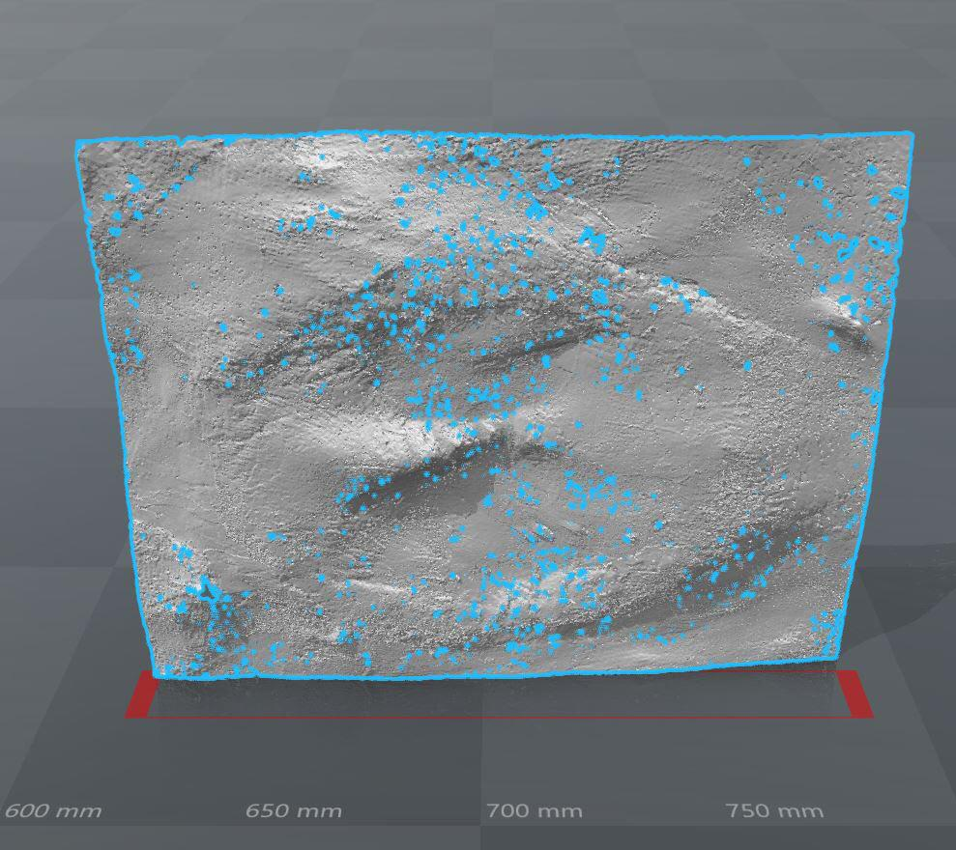
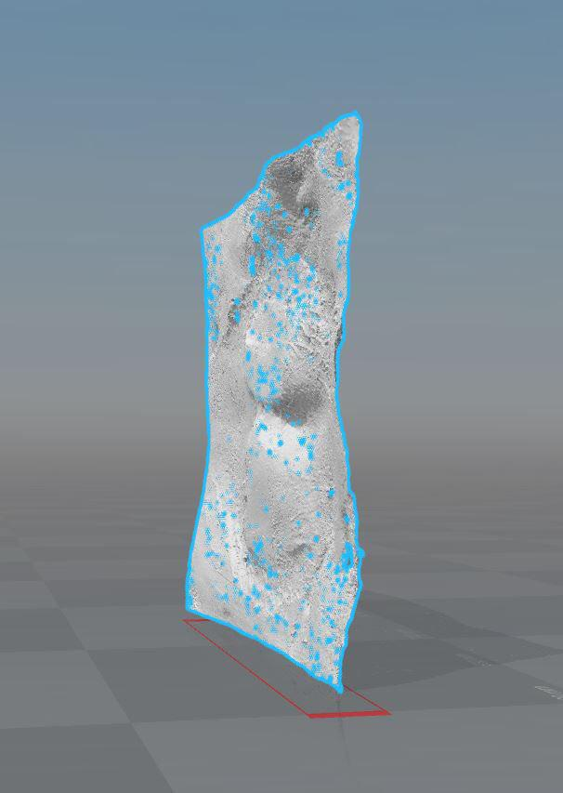
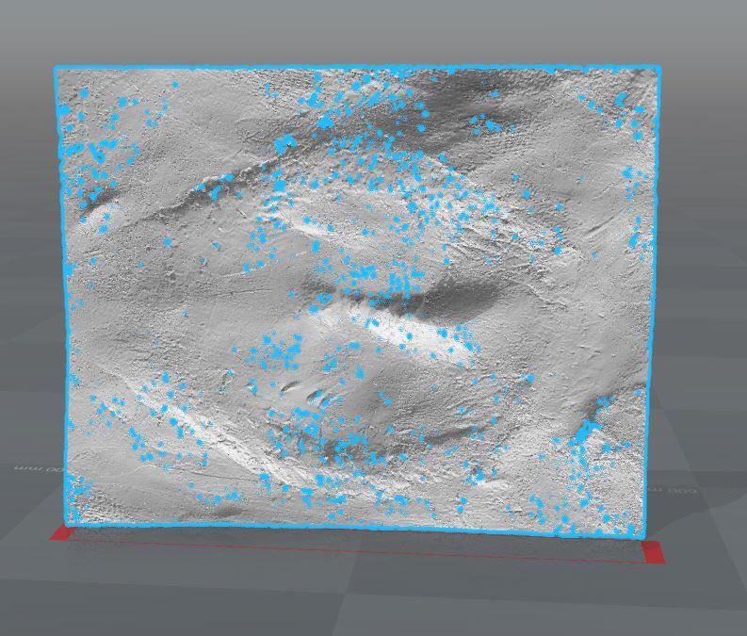
3 Scan of the Clay Mold

Slide 7
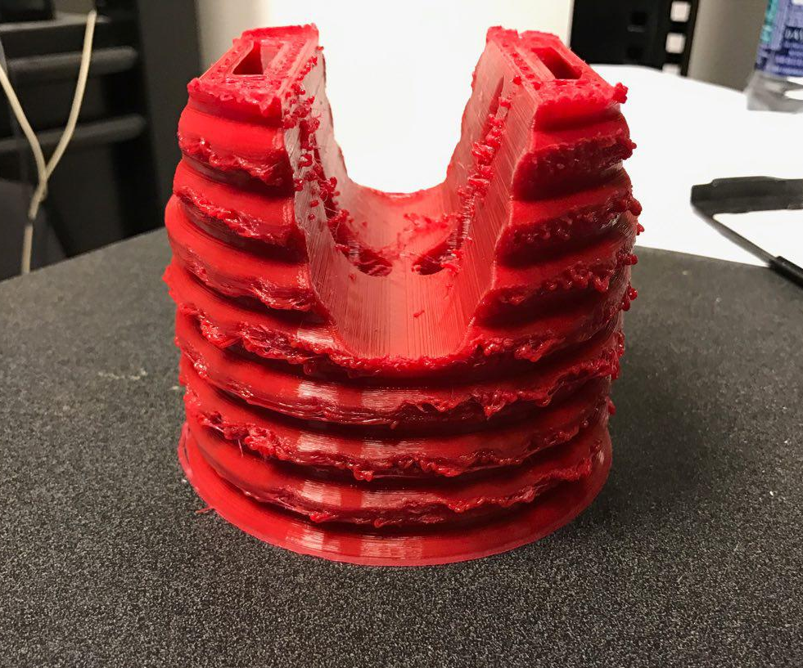
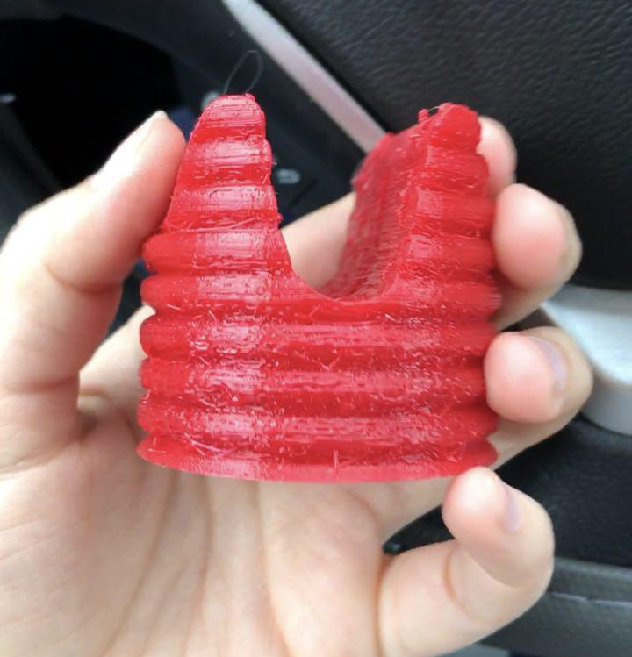
Model by 3D printing

Slide 8
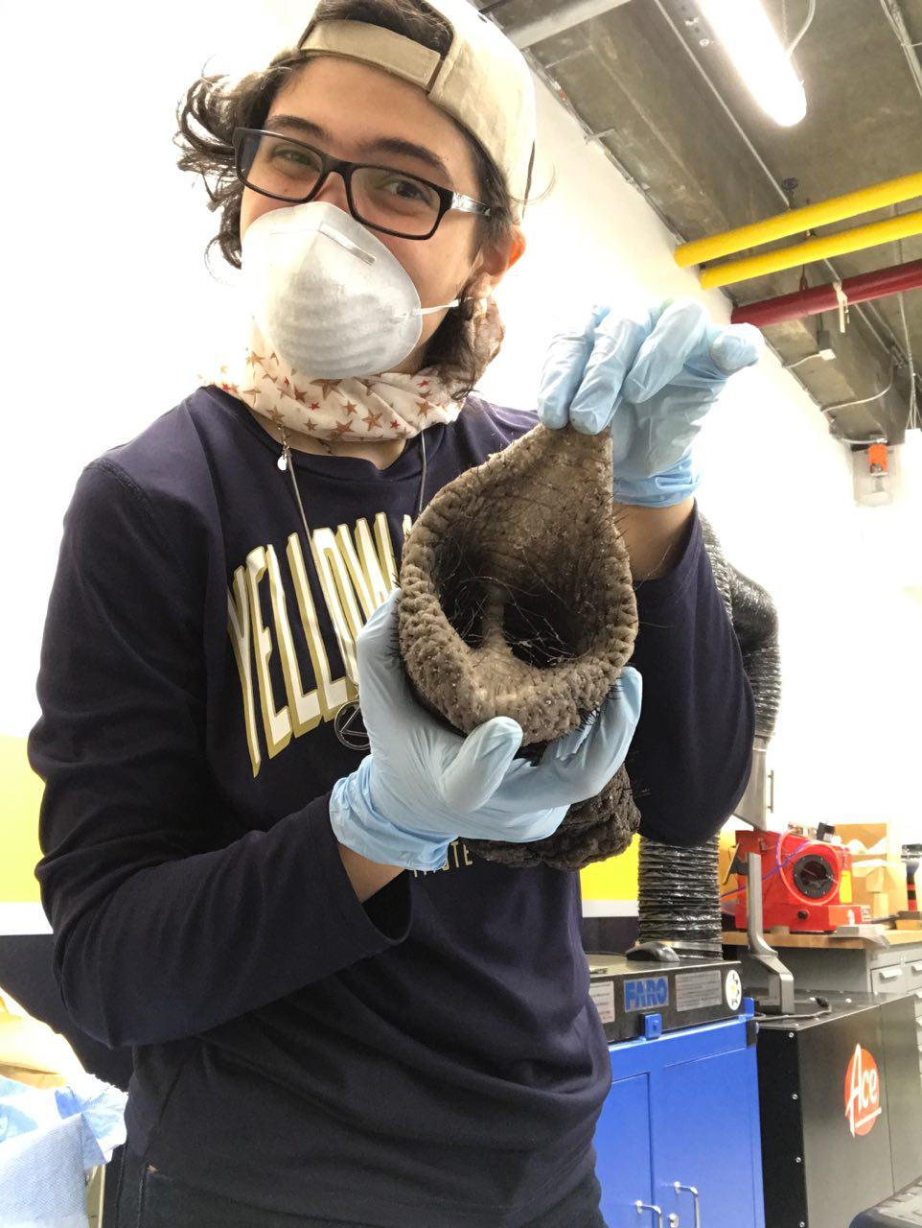
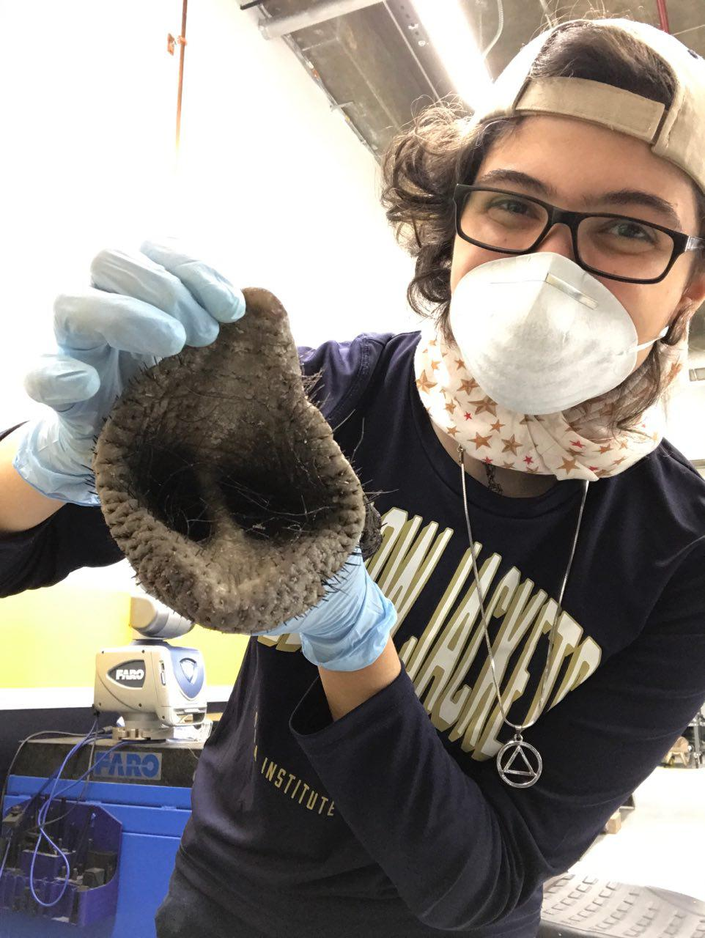
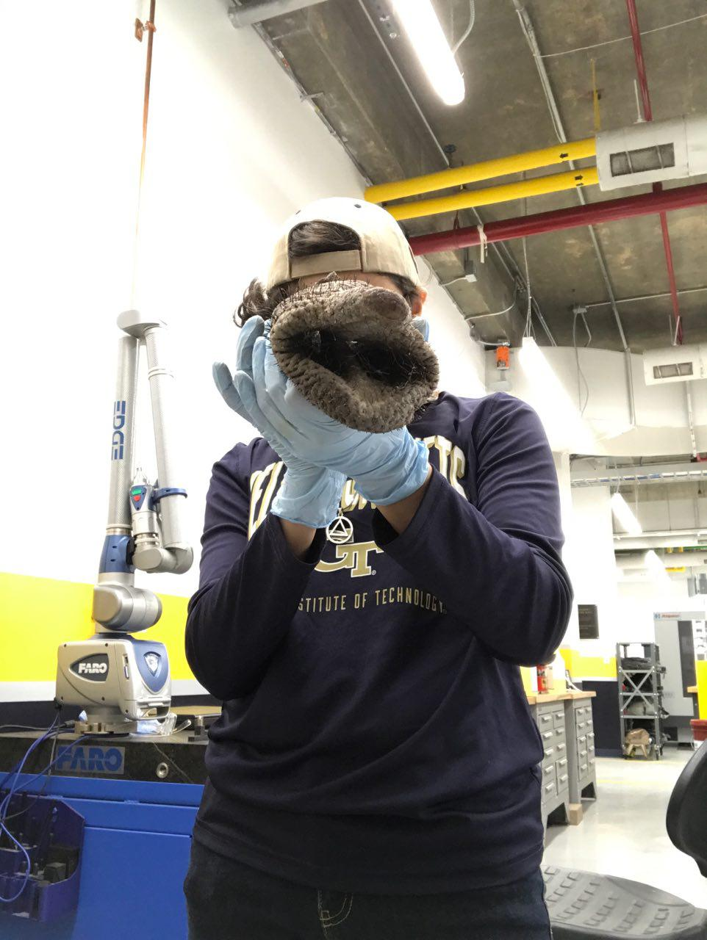
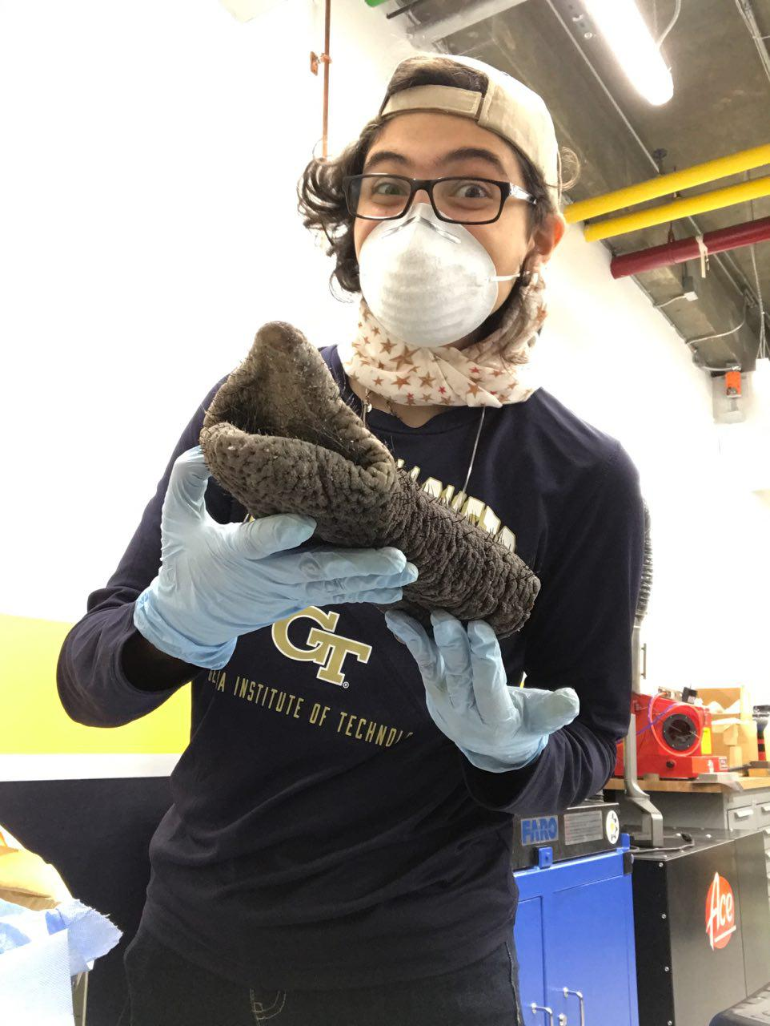
We then obtained a trunk tip sample

Slide 9
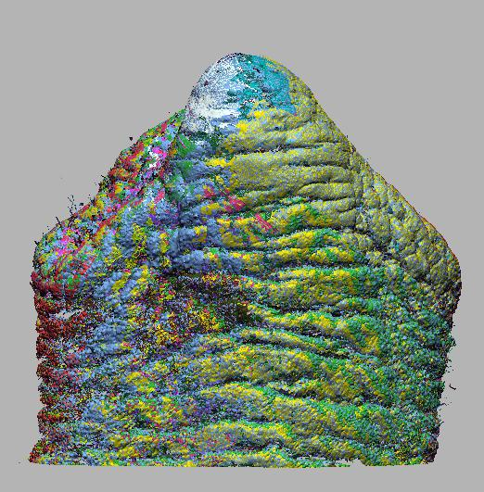
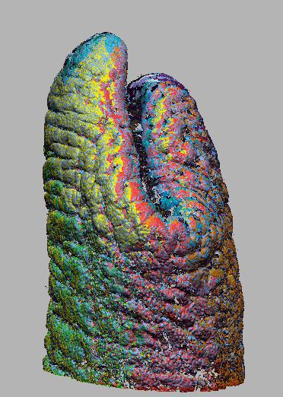
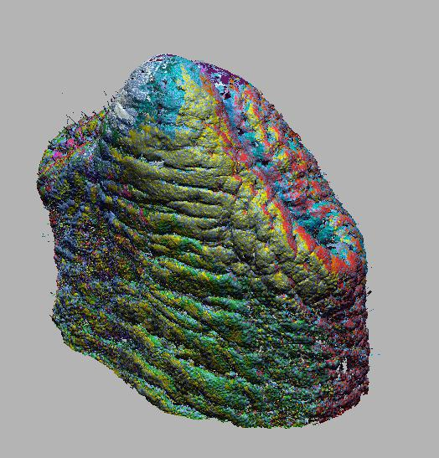
Trunk Tip Scanned
STL file for 3D printing

Slide 10
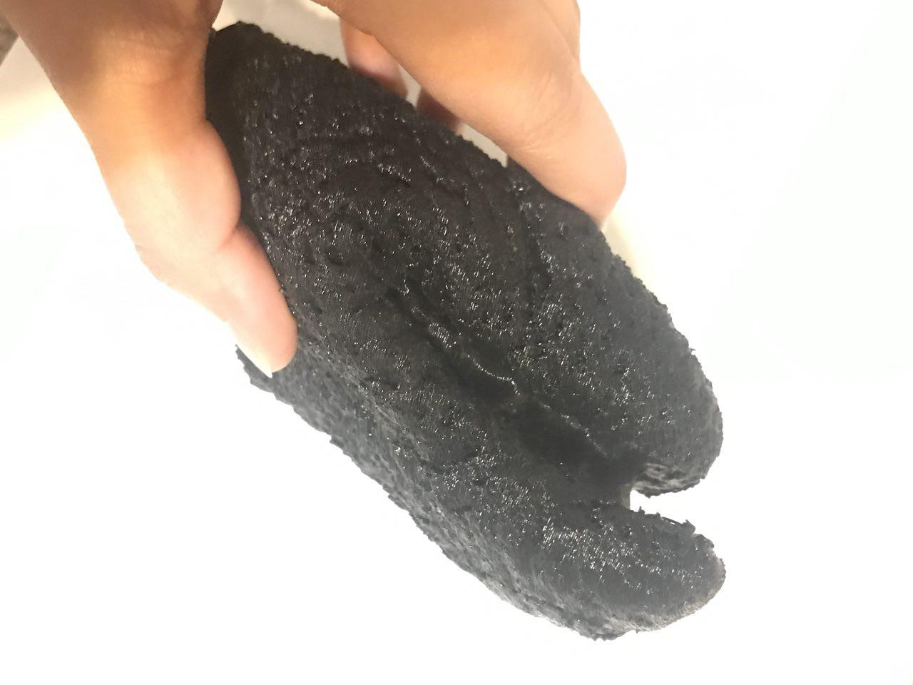
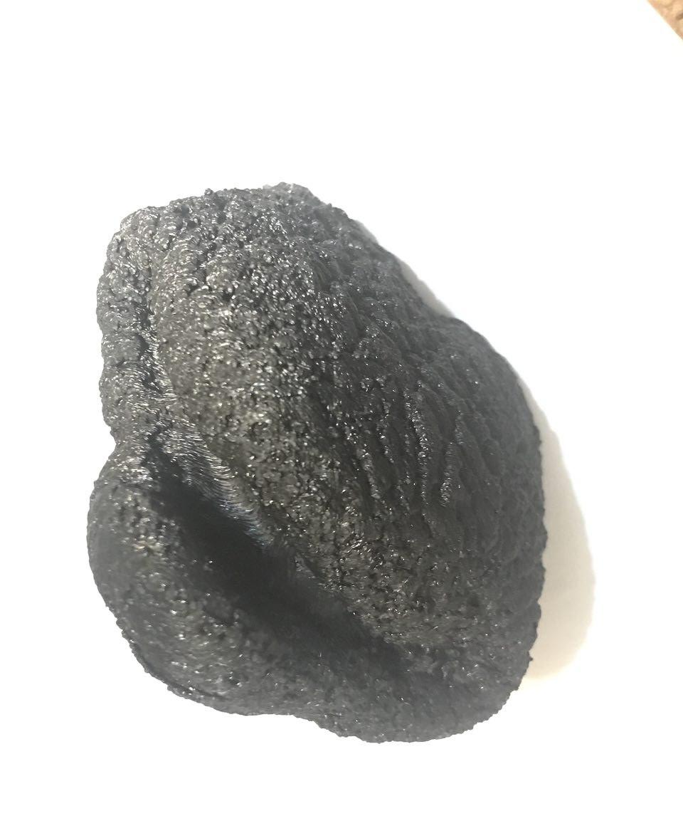
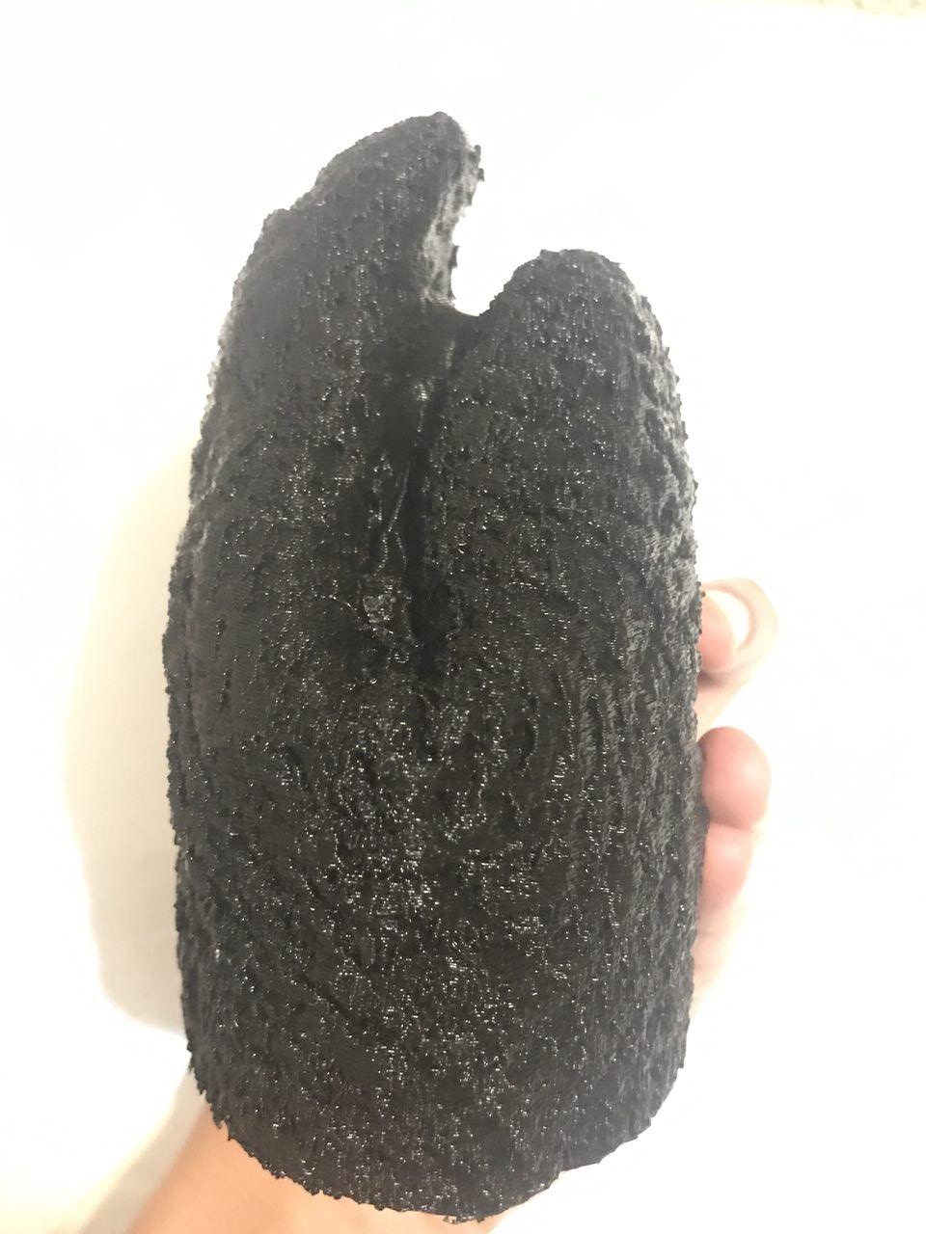
Updated 3D structure,
3D Printed, Closed Tip

Slide 11
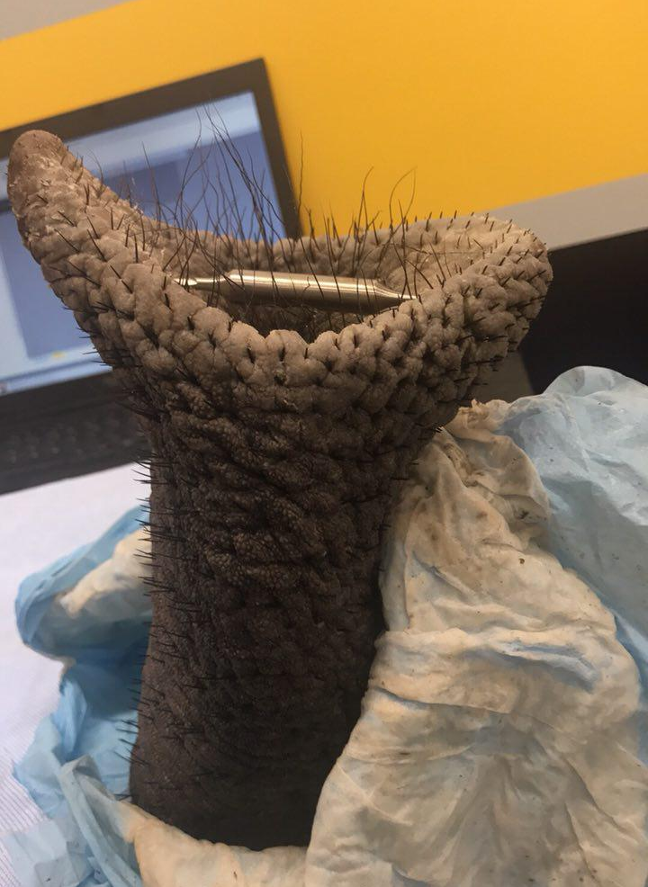
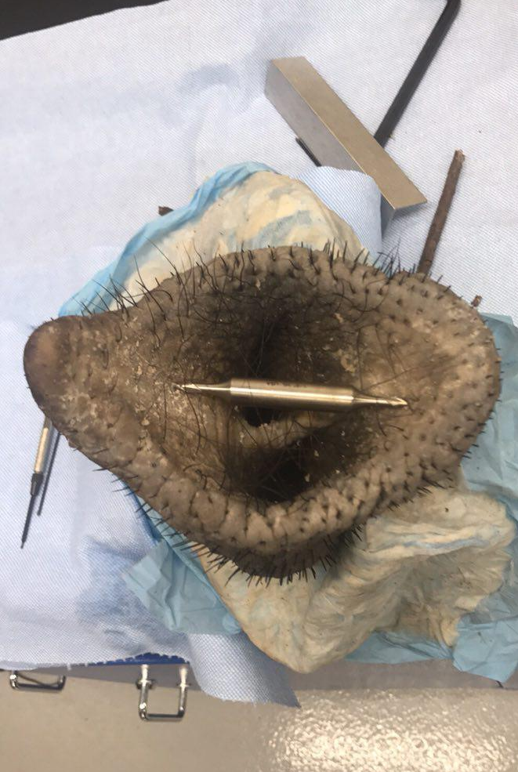
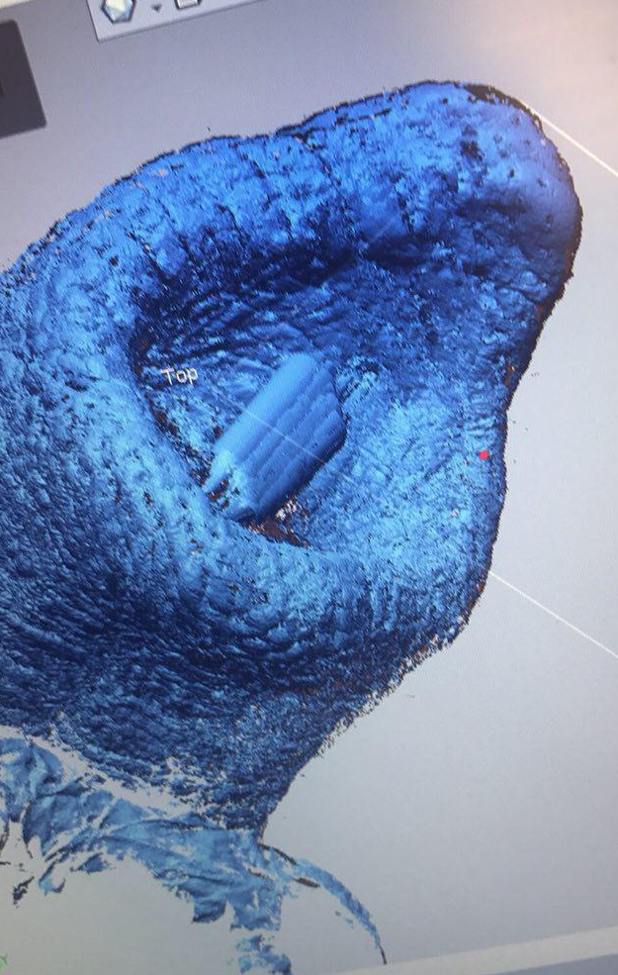
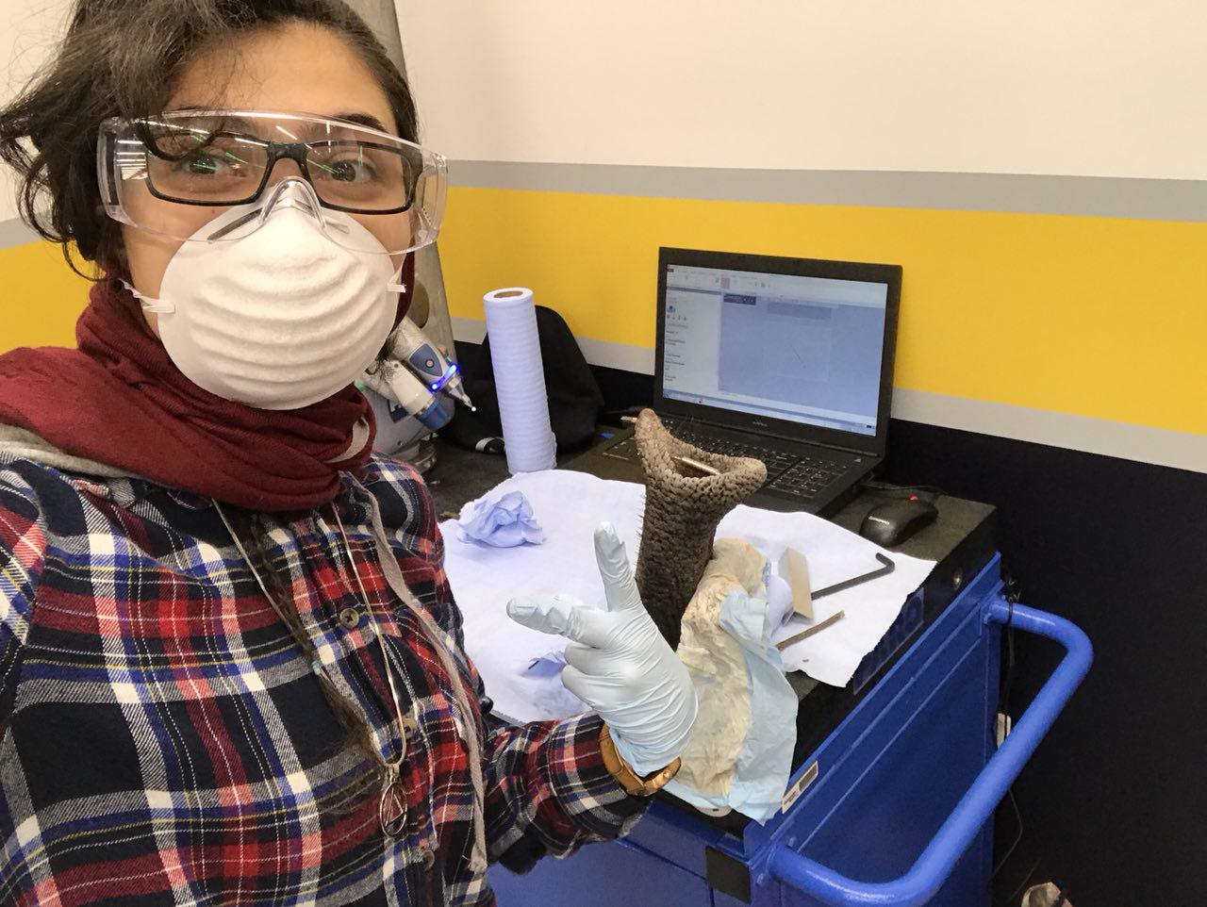
Second trial (Open Tip scanning)
FaroArm, 7 Axis

Slide 12
Future Plan
PURA Award Recipient (For Spring of 2018)
Further research on different types of soft actuators other than air pump is required
  To mimic the hydrostatic, boneless structure of the trunk
  To precisely mimic the unique bending behavior of the elephant forming temporary joints in its trunk.^{8,11}
Comparing Experiment (Cylinder vs Cone vs Trunk Tip) for suction
Better pump for lifting paper experiment
Make soft model of the actual scan captured using ExoFlex
A functioning soft robot

Slide 13
References
Deepak Trivedi, Christopher D. Rahn, William M. Kier, Ian D. Walker. Soft Robotics: Biological Inspiration, State of the Art, and Future Research. Applied Bionics and Biomechanics. 2008;5(3):99-117. doi:10.1080/11762320802557865 (the abstract)
J Robot Syst, Hannan MW, Walker ID. Kinematics and the implementation of an elephant's trunk manipulator and other continuum style robots. 2003 Feb;20(2):45-63 doi: 10.1002/rob.10070
Rano I, Santos J. A biologically inspired controller to solve the coverage problem in robotics. Bioinspired Biomim. 2017. doi: 10.1088/1748-3190/aa714c.
Hannan MW, Walker ID. Analysis and experiments with an elephant's trunk robot. Adv Robot. 2001 Dec;15(8):847-58. https://www.ncbi.nlm.nih.gov/pubmed/12741397. Accessed February 1, 2017.
Feinberg AW. Biological Soft Robotics. Annu Rev Biomed Eng. 2015;17:243-65. doi: 10.1146/annurev-bioeng-071114-040632.
Martinez RV, Branch JL, Fish CR, Jin L, Shepherd RF, Nunes RM, Suo Z, Whitesides GM. Robotic tentacles with three-dimensional mobility based on flexible elastomers. Adv Mater. 2013 Jan 11;25(2):205-12. doi: 10.1002/adma.201203002. Epub 2012 Sep 7
Delph MA 2nd, Fischer SA, Gauthier PW, Luna CH, Clancy EA, Fischer GS. A soft robotic exomusculature glove with integrated sEMG sensing for hand rehabilitation. IEEE Int Conf Rehabil Robot. 2013 Jun;2013:6650426. doi: 10.1109/ICORR.2013.6650426.
Elizabeth Pennisi. Watch an elephant pick up a tortilla chip with her trunk—without breaking it. Science. Biology plants and animals.2017. doi: 10.1126/science.aal0583
Paoletti P, Jones GW, Mahadevan L. Grasping with a soft glove: intrinsic impedance control in pneumatic actuators. J R Soc Interface. 2017 Mar;14(128). pii: 20160867. doi: 10.1098/rsif.2016.0867.
Andrew D. Marchese, Robert K. Katzschmann, Daniela Rus. A Recipe for Soft Fluidic Elastomer Robots. Soft Robot. 2015 Mar 1; 2(1): 7–25. doi: 10.1089/soro.2014.0022
Anthony Bouchard. Elephants' Trunks Are Strong, But Also Gentle. Science. Biology plants and animals.2017. https://www.labroots.com/trending/plants-and-animals/5060/elephants-trunks-strong-gentle. Accessed January 2017

Slide 14
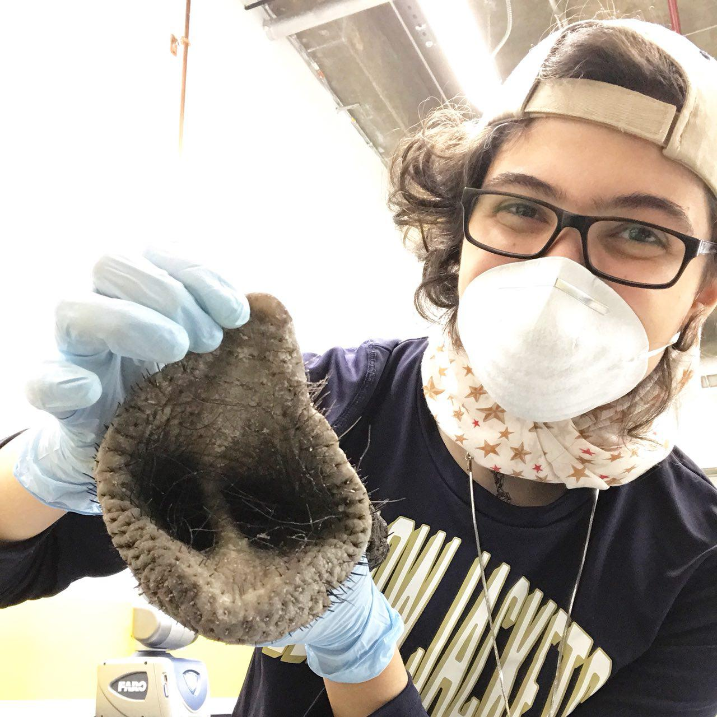
Thank You
Contact Info:
Sana3@gatech.edu

