Slide 1
Strengthening Origami Structures with Layer Jamming
Presented by: Sana Pournaghshband
Partners: Jordanna Ebanks, Charles Xiao
December 19, 2017

Slide 2
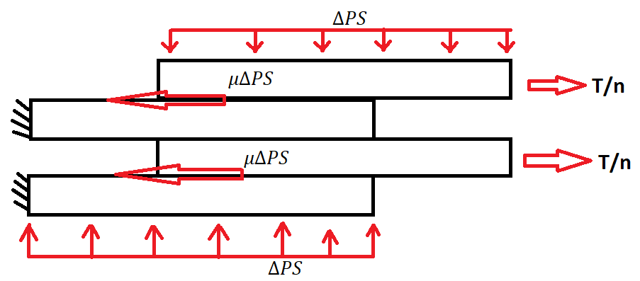
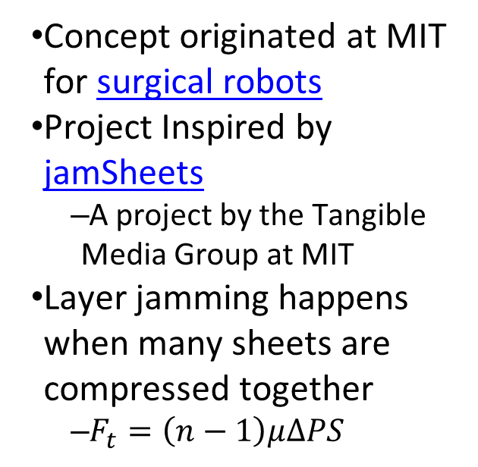
Layer Jamming Overview
Concept originated at MIT for surgical robots
Project Inspired by jamSheets
  A project by the Tangible Media Group at MIT
Layer jamming happens when many sheets are compressed together
  $F_{t}=\left(n−1\right)μ∆PS$
Notes:
n is the number of sheets. There are n-1 contacts between n sheets. Mu is the coef of friction. $∆P$ is the pressure gradient between the inside and outside of the vacuum gradient. S is the surface area.

Slide 3

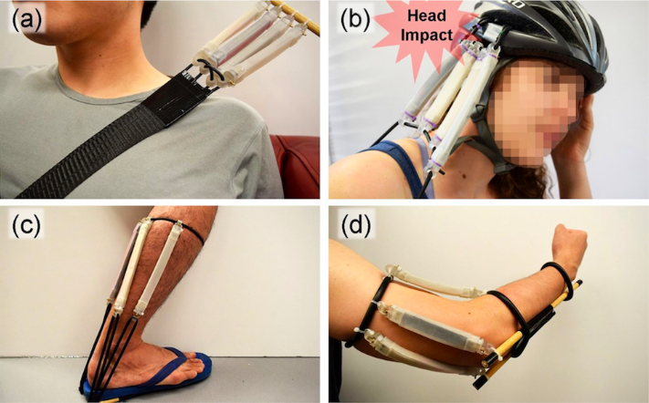
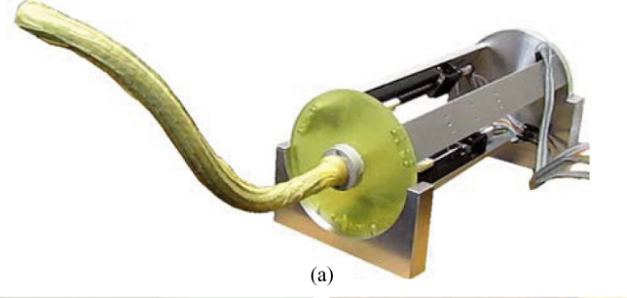
Examples of Layer Jamming
Notes:
From Top left and then counter clock wise: Chair from jam sheets; linear brake resesearch at Stanford; surgical robot that started it all

Slide 4
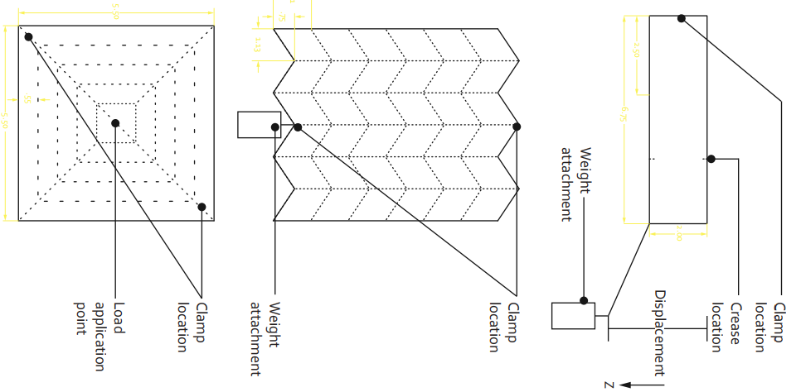
Project Overview
Bending test on different perforation ratios
Miura tensile Test
Pop through test on Hypar
  Only qualitative results
Notes:
Explain why all the tests are interesting and explain what the figures mean

Slide 5
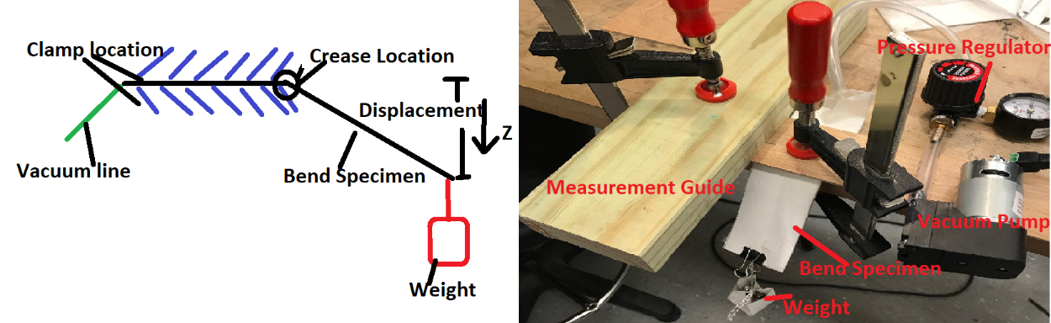
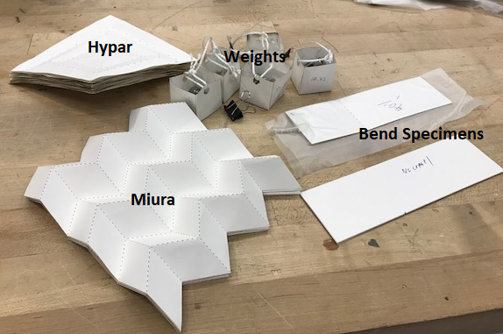
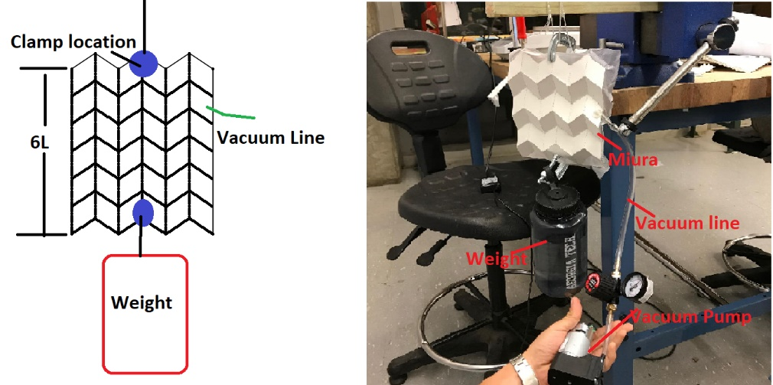
Experimental Realization

Slide 6
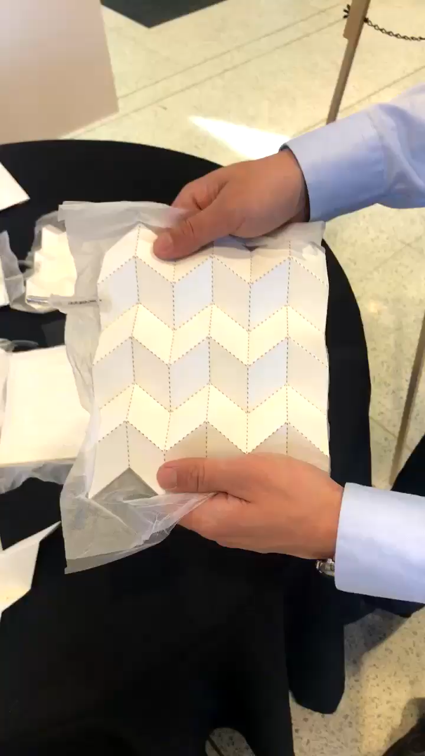
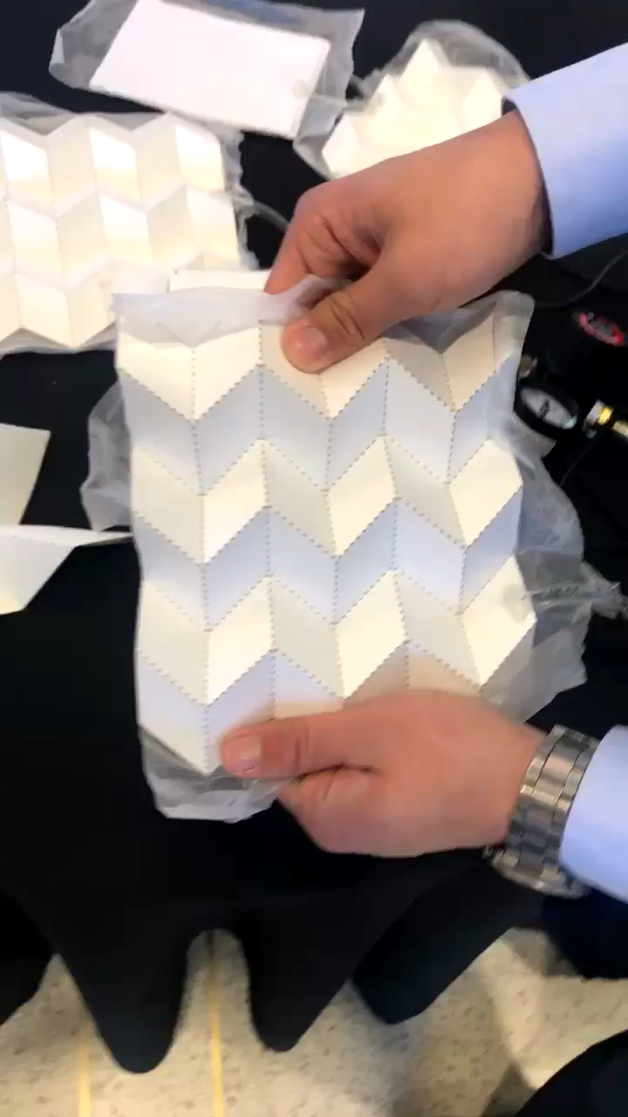
Layer Jamming in Action
Notes:
On left is no jamming

Slide 7
Bending Test Results
Increased perforations decreases bending resistance
Increasing vacuum increases bending resistance
Creases significantly decreases bending resistance
0 perforation specimens need to be fully folded
  More broken fibers
Falling Weight Deflection for Specimen with No Crease
Vacuum (psig) | -7 | -10 | -15
z-Deflection (m) | 0.037 | 0.023 | 0.0086

Slide 8
Miura Tensile Test Results
Increasing vacuum increases tensile strength
Results sensitive to folding and construction quality

Slide 9
Closing Remarks and Discussion
The pop-through of the Hypar is preserved
  Seems to be load rate dependent
Layer jamming is an effective means for strengthening origami structures
Strict fabrication procedures must be used to ensure consistency
Any questions?

